Slide 1
Decision Tree
Machine learning algorithm

Slide 2
Team 25
AMR KAMAL FATHI Section: 2 BN: 6
AMR MOHAMED AHMED Section: 2 BN: 7
MOHAMED SAYED ZAKY Section: 2 BN: 18
MAHMOUD ZAKARIA SEYAM Section: 2 BN: 25

Slide 3

What are Decision trees?
A decision tree is a tree in which each branch node represents a choice between a number of alternatives, and each leaf node represents a decision.

Slide 4
TABLE OF CONTENTS
01
02
SCIENTIFIC EXPLINATION
Build a Decision Trees
03
Implementing the decision Tree
Explination of how the decision tree works
A quick insight of how decision Trees are built from scratch
A web application that gives a prediction for diabetes

Slide 5
01
SCIENTIFIC EXPLINATION
Decision Trees usually implement exactly the human thinking ability while making a decision

Slide 6
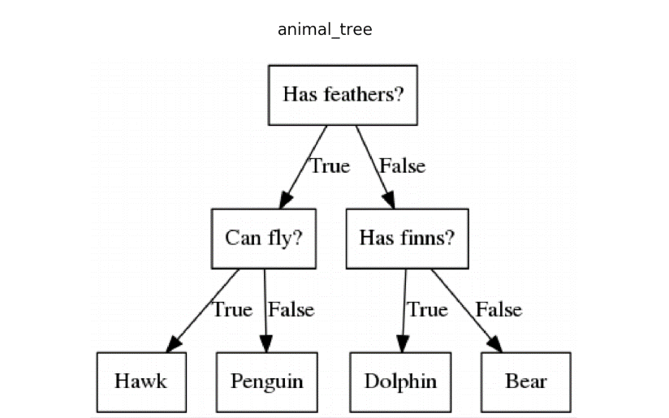
What is a Decision Tree?
Decision Trees usually implement exactly the human thinking ability while making a decision

Slide 7
Classification vs Regression Trees
Classification tree
Regression Trees
When a decision trees classifies things into categories
When a decision trees predicts numeric,

Slide 8
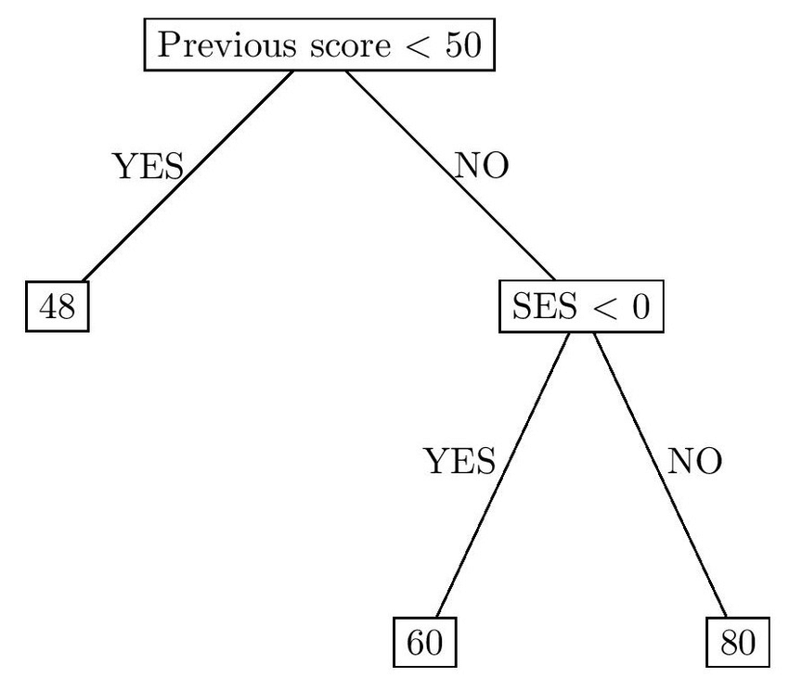
Classification vs Regression Trees
Classification tree
When a decision trees classifies things into categories, it called a classification tree
When a decision trees predicts numiric, it called a Regression Trees
Regression tree

Slide 9
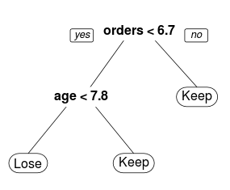
How to select split points in Decision trees
Decision tree splits the nodes on all the available variables
Selects the split which results in the most homogenous sub-nodes
There are multiple algorithms that is used by decision trees to decide the best split

Slide 10
02
BULDING A DICITION TREE
Call GINI for help

Slide 11
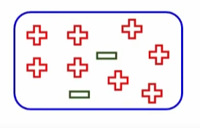
GINI IMPURITY
Gini Impurity = 1 - Gini

Slide 12
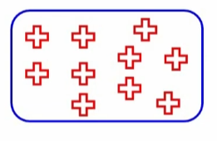
PURE GINI
Probability = 1
The higher this probability the higher the purity of the node

Slide 13
The definition of GINI Impurity
Gini index = Probability of picking two distinct elements
If you take two elements of a data set in an ordered pair what is the probability they are going to be of distinct classes

Slide 14
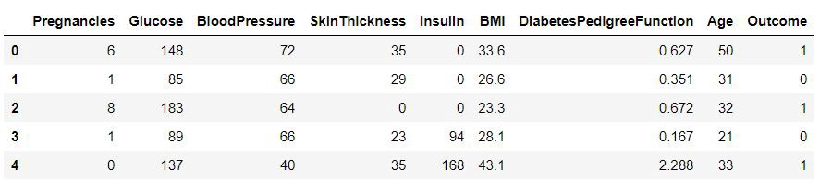
BULDING A DICITION TREE
The first step is to decide which category from the data set should be the first question of the tree

Slide 15
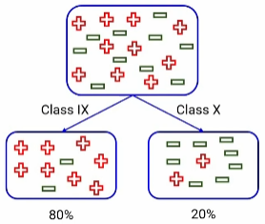
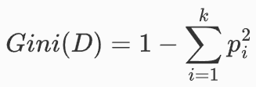
Mathematical definition
Consider a dataset D that contains samples from k classes. The probability of samples belonging to class i at a given node can be denoted as pi. Then the Gini Impurity of D is defined as:

Slide 16
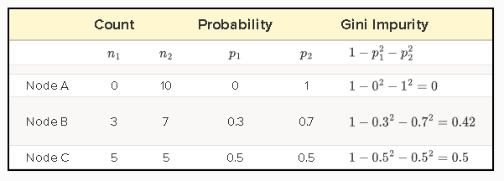
Mathematical definition
The node with uniform class distribution has the highest impurity. The minimum impurity is obtained when all records belong to the same class.
An attribute with the smallest Gini Impurity is selected for splitting the node.

Slide 17

Mathematical definition
The weighted Gini score: If a data set D is split on an attribute A into two subsets D1 and D2 with sizes n1 and n2, respectively, the Gini Impurity can be defined as:
When training a decision tree, the attribute that provides the smallest Gini a(D) is chosen to split the node.

Slide 18
Mathematical definition
-To calculate the GINI impurity for a numeric class the first thing we do is to sort the class from the lowest value to the highest value
-Then create all possible split points by calculating the average age of each two values
-calculate the weighted Gini impurity for each candidate split point
-pick the points that provide the smallest weighted Gini impurity

Slide 19
03
IMPLEMENTING
Predict diabetes

Slide 20
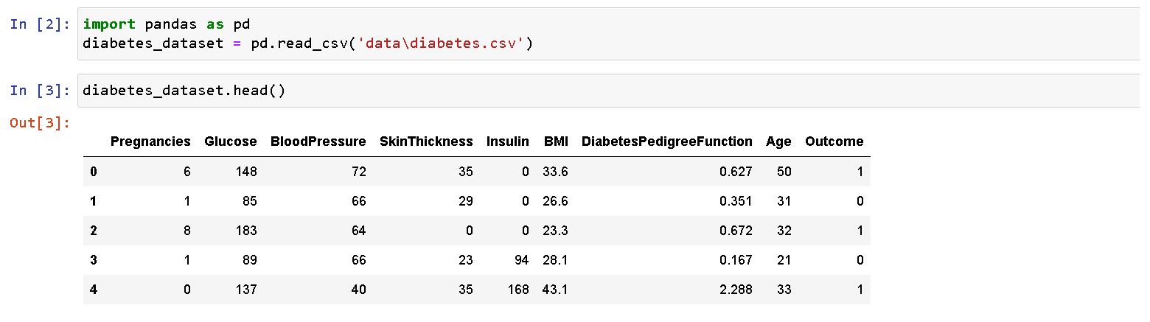
LOAD THE CSV FILE
The first step is to decide which category from the data set should be the first question of the tree

Slide 21
A Quick look to the dataset
In this data set we have eight different categories and the outcome is
0 when the patient is not diabetic
1 when the patient is diabetic

Slide 22
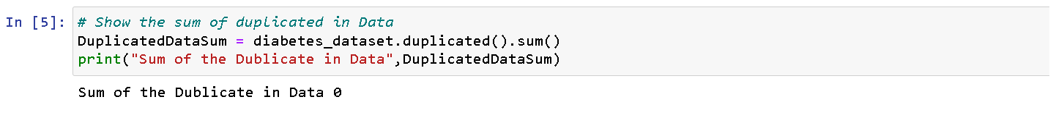
Checking for duplicated rows

Slide 23
Splitting the Outcome column
By using the method .drop()

Slide 24
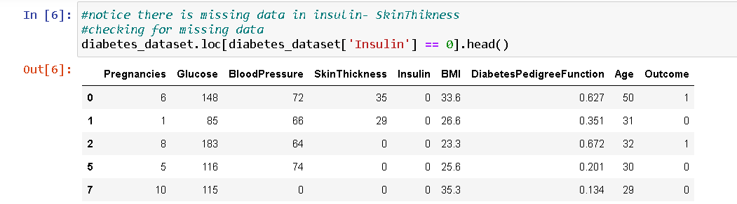
Dealing with missing data (1)
The first thing to observe that there are a lot of zeros in insulin
The insulin level in humans can never be zero
Also skin thickness , blood pressure , BMI
Have the same problem

Slide 25
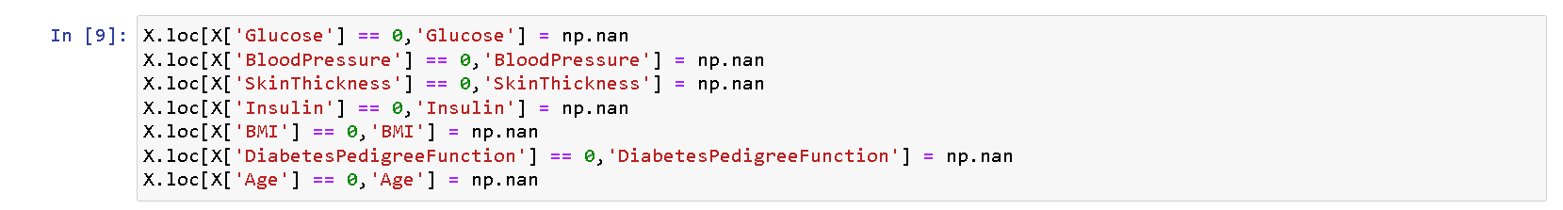
Dealing with missing data (2)
Here we replace all the missing values that equal 0 with np.nan, so it can not affect the next analysis

Slide 26
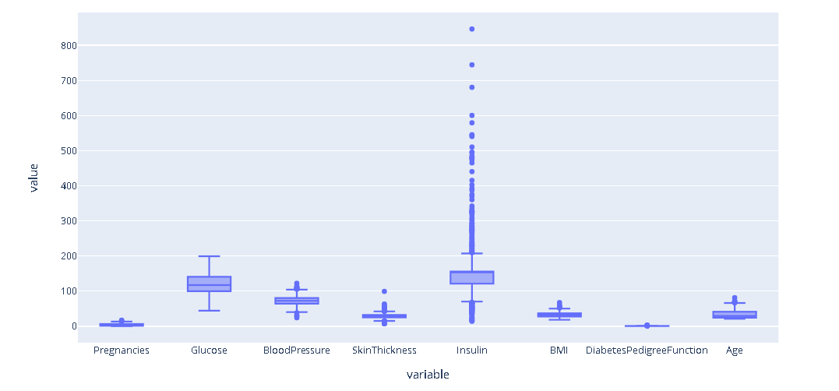
Checking for outliers

Slide 27
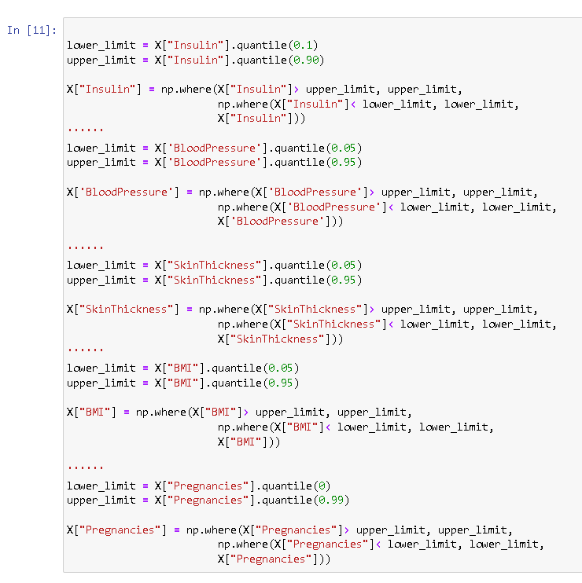
Removing outliers
1- assign the lower and the upper limit
2-replace the outlier with the lower or upper limit

Slide 28
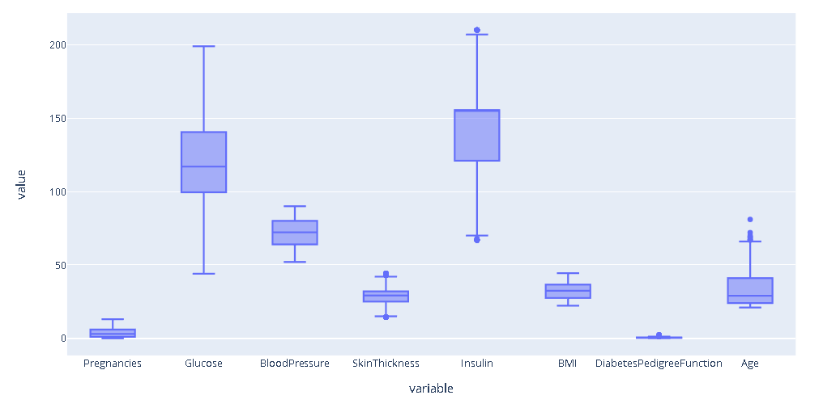
Outliers removed

Slide 29
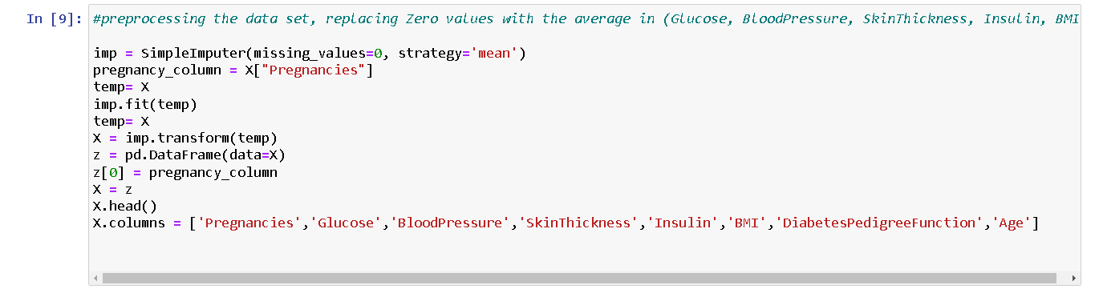
Dealing with missing data (3)
Sklearn provides a class that deals with missing values
(SimpleImputer)
By replacing the missing values with the mean of the available values

Slide 30
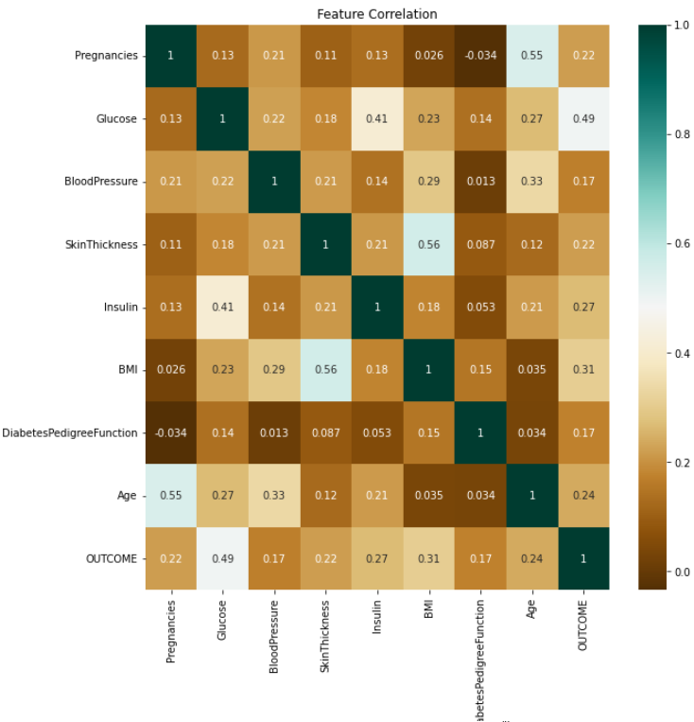
The correlations between different category

Slide 31
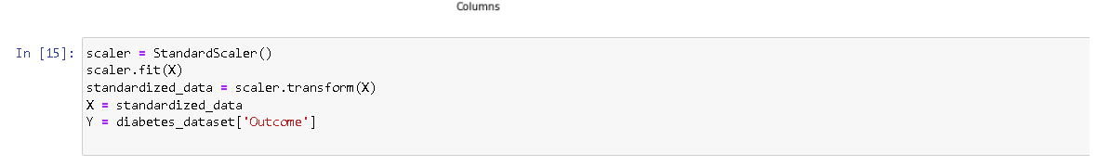
Standardizing the data
By calculating the mean and the standard deviation for every column
Calculating the z score for each measurement

Slide 32
Splitting training and testing data
With 30% ratio, the data set is split to train and test the data

Slide 33
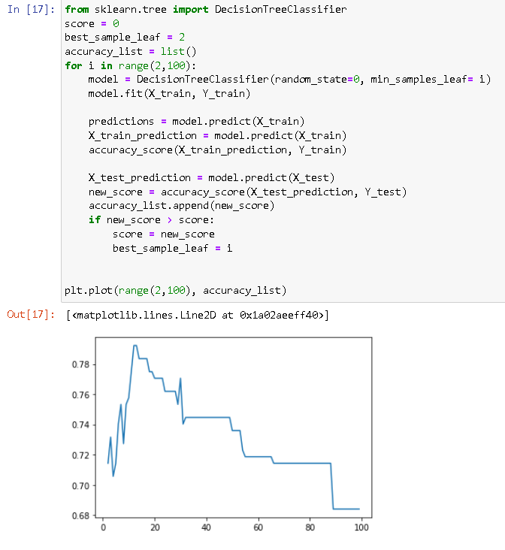
Training the algorithm
We ran the training code inside a for loop trying to find the best possible parameters for the model to prevent overfitting to increase the accuracy
We trained the model multiple times to discover the best minimum samples that should be on the ending leaf
A split point at any depth will only be considered if it leaves at least min_samples_leaf training samples in each of the left and right branches.

Slide 34
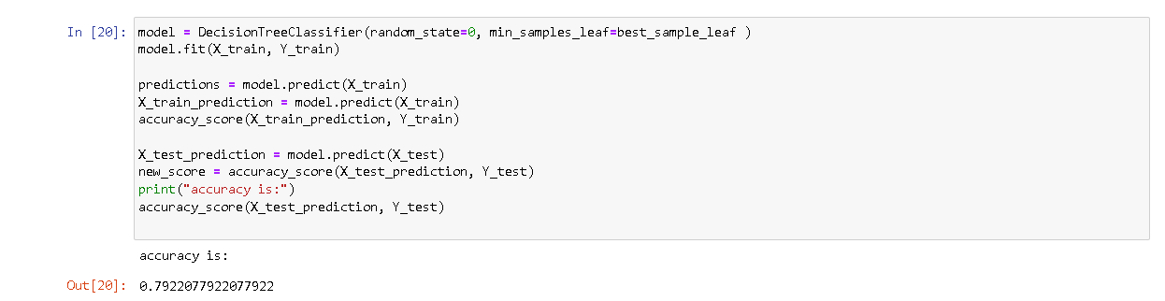
Training the algorithm
For the last time, we train the model but with the best minimum leaf samples
The accuracy of the model is 79%

Slide 35
THANK YOU

